Slide 1
Future tax leaders – employment tax updates
April 27, 2023

Slide 2
Disclaimer
EY refers to the global organization and may refer to one or more, of the member firms of Ernst & Young Global Limited, each of which is a separate legal entity. Ernst & Young LLP is a client-serving member firm of Ernst & Young Global Limited operating in the US.
This presentation is © 2023 Ernst & Young LLP. All Rights Reserved. No part of this document may be reproduced, transmitted or otherwise distributed in any form or by any means, electronic or mechanical, including by photocopying, facsimile transmission, recording, rekeying, or using any information storage and retrieval system, without written permission from Ernst & Young LLP. Any reproduction, transmission or distribution of this form or any of the material herein is prohibited and is in violation of US and international law.
Ernst & Young LLP expressly disclaims any liability in connection with use of this presentation or its contents by any third party.
Views expressed in this presentation are those of the speakers and do not necessarily represent the views of Ernst & Young LLP.
This presentation is provided solely for the purpose of enhancing knowledge on tax matters. It does not provide tax advice to any taxpayer because it does not take into account any specific taxpayer’s facts and circumstances.
These slides are for educational purposes only and are not intended and should not be relied upon, as accounting advice.

Slide 3
Presenters
Jocelyne Miller
Managing Director
Exempt Organization Tax Services
Ernst & Young LLP
San Diego, CA
Presenters
Stephen LaGarde
Principal
National Tax Compensation and Benefits
Ernst & Young LLP
Washington, DC
Stephanie Pfister
Senior Manager
Employment Tax
Ernst & Young LLP
San Francisco, CA

Slide 4
Objectives
After successful completion of this course, participants should be able to:
Apply final regulations into methodology for complying with IRC section 4960 tax on excess executive compensation
Use Form 990 compensation reporting as a tool to promote compensation best practices
Recognize the IRS and states latest views on Employee Retention Credit, state relief payments and employees working outside employer jurisdictions

Slide 5
Agenda
1
Section 4960 update
2
Employment tax considerations for exempt organizations
3
Compensation reporting on Form 990
A
Who is reported?
B
What is reported in Part VII?
C
Detailed compensation questions – Schedule J
4
Remote worker tax and other considerations
Notes:
Note to content author:
The agenda should be laid out so that topics covered during the course directly relate back to stated objectives.

Slide 6
Section 4960 update

Slide 7
Section 4960 guidance
Final regulations generally apply to taxable years beginning after December 31, 2021
Since then, taxpayers may have relied on:
Reasonable, good faith interpretations of the statute that include consideration of any relevant legislative history
Notice 2019-09 in its entirety
Proposed regulations in their entirety
Final regulations in their entirety

Slide 8
Section 4960 overview
For tax years beginning after December 31, 2017, section 4960 imposes a 21% excise tax on (1) remuneration in excess of $1m paid for a tax year or (2) any “excess parachute payments” paid to “covered employees” of any applicable tax-exempt organization (ATEO) or related organization
By the numbers
Excess remuneration | >$1m
Parachute payments | Separation pay >3x “base amount”
Excise tax | 21%

Slide 9
Polling question 1
Q
What approach to 4960 compliance did your employer/clients take?
A
Set a methodology based on an interpretation of the statute
B
Set a methodology based on Notice 2019-09 in its entirety
C
Set a methodology based on proposed regulations in their entirety
D
Set a methodology based on the final regulations in their entirety
E
None of the above

Slide 10
Section 4960 remuneration
Remuneration is used both for identifying top five employees and for applying the $1,000,000 limit.
It includes amounts paid by related organizations.
Vesting-based timing rule applies to everything but salary (e.g., bonuses, 457(f) plans, nongovernmental 457(b) plans), which may not match box 1 on Form W-2.
Earnings in 457(f) and nongovernmental 457(b) plans must be included annually:
Employee-by-employee earnings must be calculated across all plans of each employer.
Losses can offset earnings, but not contributions/benefit accruals, so net losses carry forward.
The value of group-term life insurance in excess of $50,000 is not included, even though it is reported in box 1 of Form W-2.

Slide 11
Interesting section 4960 issues
Less interesting
Governmental vs. nongovernmental 357(b) plans
403(b) plans
Permanent losses
More interesting
Which entity is the common law employer?
Payments to beneficiaries
Interplay with section 162(m)(6)

Slide 12
Section 4960 enforcement activity
“Compliance check information requests”
Examinations

Slide 13
Employment tax considerations for exempt organizations

Slide 14
Coronavirus Aid, Relief and Economic Security (CARES) Act revisited
Status of employee retention credit
2020 – Statute for claiming credit expires April 15, 2024
2021 – Statute for claiming credit expires April 15, 2025
IRS backlog for processing Forms 941-X
Forms 941-X being flagged for audit
Common issues with repayment of payroll tax deferral (employer portion of social security taxes)
January 3, 2022 – Payment 1
January 3, 2023 – Payment 2
Section 127 expansion for student loans
Originally applied only for 2020
Later extended through 2025
Discontinuation of 139 disaster relief payments (not part of CARES Act)

Slide 15
California Healthcare Retention Payments
One-time bonus funded by the State of California 2020 to qualified health care workers
$1,000 for fulltime workers, plus the amount of matching retention payment for a maximum state payment of $1,500
$750 for part-time workers, plus the amount of matching retention payment for a maximum of $1,250
Eligible physicians receive $1,000
State releases payments to employers for distribution to employees
No clear guidance on whether payment is considered wages subject to employment taxation and W-2 reporting or Form 1099 reporting
Funds must be distributed within 60 days of receipt

Slide 16
Polling question 2
Q
Which of the following statements reflect compliance with the rules just discussed?
A
The payroll tax deferral will be repaid by the end of calendar 2023.
B
We’re currently tracking COVID-related sick days for the Employee Retention Credit.
C
The CA employee bonus payments can either be paid to eligible employees or applied to their benefit.
D
The CARES Act is over; the usual tax rules apply.
E
None of the above.

Slide 17
Compensation reporting on Form 990

Slide 18
Polling question 3
Q
Which of the following is true about accurate Form 990 compensation reporting?
A
It ties perfectly to the employee’s Form W-2.
B
It can help the organization avoid an automatic excess benefit transaction.
C
Only the highest-compensated employees are reported.
D
It is reasonable compensation by definition.

Slide 19
Who is reported?

Slide 20
Current directors or trustees
Disclose all current directors and trustees.
A director/trustee is a voting member of the organization’s governing body.
Often receive no reportable compensation.
“Current” means having served even one day of the tax year.
Tip
Consider carefully who should be reported when terms begin or end on dates other than the beginning or ending of the tax year.

Slide 21
Current officers
An officer is any person elected or appointed to manage the organization’s daily operations, such as a president, vice president, secretary or treasurer.
Refer to organizing documents.
Include “officers of the board” and “officers of the corporation.”
Consider state law rules designating as officers those individuals working in certain functions.
According to Form 990 instructions, always include the organization’s top management official and top financial official:
Top management official (e.g., president, CEO or executive director)
Top financial official (e.g., treasurer or CFO)
Not everyone with “officer” in his or her title is automatically included.
Disclose all current officers, regardless of compensation.

Slide 22
Current key employee
Key employee — an employee of the organization (other than an officer, director or trustee) who meets all three of the following tests:
$150,000 test — receives reportable compensation from the organization and all related organizations in excess of $150,000 for the calendar year ending with or within the organization’s tax year (calendar year 2021 for taxpayers with a June 30, 2022, tax year-end)
Responsibility test — has wide control similar to an officer, director or trustee; control over 10% of the organization’s activities, assets, income or expenses; or has authority or shares authority to control or determine 10% or more of the organization’s capital expenditures, operating budget or compensation for employees
Top 20 test — is among the 20 employees with the highest reportable compensation from the organization and related organizations for the calendar year ending with or within the organization’s tax year (calendar year 2021 for taxpayers with a June 30, 2022, tax year-end)

Slide 23
Current five highest-compensated employees
The five highest-compensated employees (other than officers, directors, trustees or key employees) who received over $100,000 in reportable compensation from the organization or any related organizations:
Reportable compensation is W-2 Box 5 or 1099-NEC Box 1 wages.
Related organizations are determined by completing Schedule R.
Tip
Before determining who must be reported on your organization’s Part VIII, Schedule R needs to be completed (definition of related organization and control).

Slide 24
Other considerations
Disregarded entities (such as single-member LLCs that are not treated as separate entities for federal income tax purposes) are treated as a division of the organization for purposes of Form 990.* An officer or director of the single-member LLC may qualify as a key employee or highest-compensated employee.
Management and/or employee leasing companies:
Company could be listed as independent contractor.
Organization should report employees of employee leasing company or a management company as the organization’s own employees if such persons are common-law employees of the filing organization.
Common paymaster or payroll agent:
Treat amounts paid by a common paymaster or a payroll or reporting agent for services performed for the organization as if paid directly by the organization.
Common-law employees are determined based on federal law, not state law effective for 2022 Form 990.
Tip
Know the details of any management company or leasing company situations.
*Note: single-member LLCs are “regarded” for employment and some other tax purposes.

Slide 25
Polling question 4
Q
Which two of the categories can a single individual report as?
A
Director/trustee and highest-compensated employee
B
Key employee and officer
C
Key employee and highest-compensated employee
D
Director/trustee and officer

Slide 26
Former officers, directors, trustees, key employees (ODTKE) and highest-compensated employees (HCE)
Reported if certain circumstances apply
The organization reported (or should have reported) an individual on any of the organization’s Forms 990, 990-EZ or 990-PF for any one or more of the five prior years in one or more of the following capacities:
Officer
Director or trustee
Key employee
Highest-compensated employee
The individual received reportable compensation, from the organization and/or related organizations, in the calendar year ending with or within the organization’s current tax year in excess of the threshold amount:
$100,000 for former officers, key employees and HCE
$10,000 for former directors or trustees for services rendered in their capacity as a former director or trustee
Tip
Use the calendar year ending within the organization’s tax year to determine all “former” persons because their status depends on their reportable compensation, which is reported for the calendar year.

Slide 27
Special rules for former highest-compensated employees
All four conditions below need to apply (in the calendar year ending with or within the organization’s current tax year) for a former highest-compensated employee to be reported:
The individual wasn’t an employee of the organization.
The individual was reported (or should have been reported, under the instructions in effect for such years) on any of the organization’s Forms 990, 990-EZ or 990-PF for one or more of the five prior years as one of the five highest compensated employees.
Reportable compensation exceeded $100,000.
The amount of the individual’s reportable compensation for the year would place him or her among the organization’s current five highest- compensated employees if the individual were an employee.

Slide 28
Special rules for former highest-compensated employees
Example
Organization has a June 30 year end.
Hector worked as an organization employee, and June 30 of the prior year was his last day.
For the prior year Form 990, Hector was reported as a highest-compensated employee on Part VII and Schedule J.
For the calendar year ended within the fiscal year, Hector received $130k in reportable compensation and other compensation, all of which was paid for work performed during the first six months of the calendar year, the portion of the calendar year before the start of the fiscal year.
Besides directors/trustees, officers and key employees, at least five individuals were paid more than $130k in total compensation.
Hector is not reported as a former highest-compensated employee.

Slide 29
Which individuals have additional compensation reporting on Schedule J?
Schedule J is required for additional compensation reporting on individuals listed in Part VII who:
Are listed as a former officer, director, trustee, key employee or HCE
Have reportable compensation and other compensation greater than $150,000, or
Receive or accrue compensation from any unrelated organization or individual for services rendered to the organization

Slide 30
Matrix for Form 990, Part VII, Section A
Position | Current or former | Enter on Form 990, Part VII, Section A … | Enter on Schedule J (Form 990), Part III …
Directors and trustees | Current | All | If reportable and other compensation is greater than $150,000 in the aggregate from organization and related organizations (don’t report institutional trustees)
 | Former | If reportable compensation in capacity as former director or trustee is greater than $10,000 in the aggregate from organization and related organizations | If listed on Form 990, Part VII, Section A (don’t report institutional trustees)
Officers | Current | All | If reportable and other compensation is greater than $150,000 in the aggregate from organization and related organizations
 | Former | If reportable compensation in capacity as former director or trustee is greater than $100,000 in the aggregate from organization and related organizations | If listed on Form 990, Part VII, Section A
Key employees | Current | All | All
 | Former | If reportable compensation is greater than $100,000 in the aggregate from organization and related organizations. | If listed on Form 990, Part VII, Section A
Other | Current | If reportable compensation is greater than $100,000 in the aggregate from organization and related organizations. | If reportable and other compensation is greater than $150,000 in the aggregate from organization and related organizations
 | Former | If reportable compensation is greater than $100,000 in the aggregate from organization and related organizations. | If listed on Form 990, Part VII, Section A

Slide 31
What is reported in Part VII?

Slide 32
What is compensation for Form 990 purposes?
Part VII requires disclosure of two categories of compensation:
“Reportable compensation” from filing organization and related organizations
“Other compensation” from filing organization and related organizations
Schedule J, Part II requires organizations to break these general categories into more detail.

Slide 33
Calendar vs. fiscal year
Compensation must be reported for the calendar year ending with or within the organization’s tax year, even if the fiscal year is used to determine which such persons must be listed in Part VII (e.g., current officers, directors and trustees).
The amount of compensation reported on Form 990, Part VII, for a listed person may differ from the amount reported on Form 990, Part IX, line 5, for that person due to factors such as a different accounting period (calendar vs. fiscal year) or a different accounting method.

Slide 34
Reportable compensation
For employees, Form W-2, box 1 or 5 (whichever is greater)
Form 1099-NEC, box 1 (nonemployee compensation) for services to organization or related organization
Form 1042-S box 2
Actual amount paid for services if Form W-2 or Form 1099-NEC or Form 1042-S is not required to be filed

Slide 35
Polling question 5
Q
An individual works for a US nonprofit from an overseas location as an independent contractor. Individual relocates to the US and continues the same independent contractor work. Individual is finally hired as an employee. If all of this occurred in a single calendar year, individual might have reportable compensation on which Form(s)?
A
W-2
B
1099-MISC
C
W-2 and 1099-MISC
D
1042-S, 1099-NEC and W-2

Slide 36
Reportable compensation
Schedule J, Part II breaks reportable compensation into categories:
Base compensation:
Pay that makes up the normal work week
Bonus and incentive compensation, including but not limited to:
Signing bonus
Management incentive plan
Other reportable compensation, including but not limited to:
Current-year payments of amounts earned in a prior year
Payments under a severance plan
Deferred amounts and earnings or losses in a nonqualified defined contribution plan subject to Section 457(f) when substantially vested
Awards based on longevity of service
Taxable benefits
Sick pay or PTO cash-out
Form 1099-MISC box 6 (medical and health care payments)

Slide 37
Other compensation
Compensation, other than reportable compensation, including:
Deferred compensation not currently reportable on Form W-2, box 1 or 5 or Form 1099-NEC, box 1:
Current-year deferrals under any retirement or other deferred compensation plan, qualified or nonqualified, established, sponsored or maintained by or for organization or a related organization
Annual increase or decrease in actuarial value of defined benefit plan
Certain nontaxable benefits, including but not limited to:
Educational assistance
Health insurance and medical reimbursement programs
Life, disability and long-term care insurance
Dependent care and adoption assistance
Does not include disregarded benefits, such as certain fringe benefits and reimbursement made pursuant to an accountable plan
Tip
Not all components of compensation are run through payroll; consult with payroll and benefits.

Slide 38
Schedule J, Part II, column (F)
Payment reported in current-year column (B) — i.e., reportable compensation — to the extent such payment was reported as deferred compensation on a prior Form 990
Example: Section 457(f) nonqualified plan amounts that were reported as deferred in column (C) in a prior year but have substantially vested in current year, thus requiring them to be reported in column (B)(iii)

Slide 39
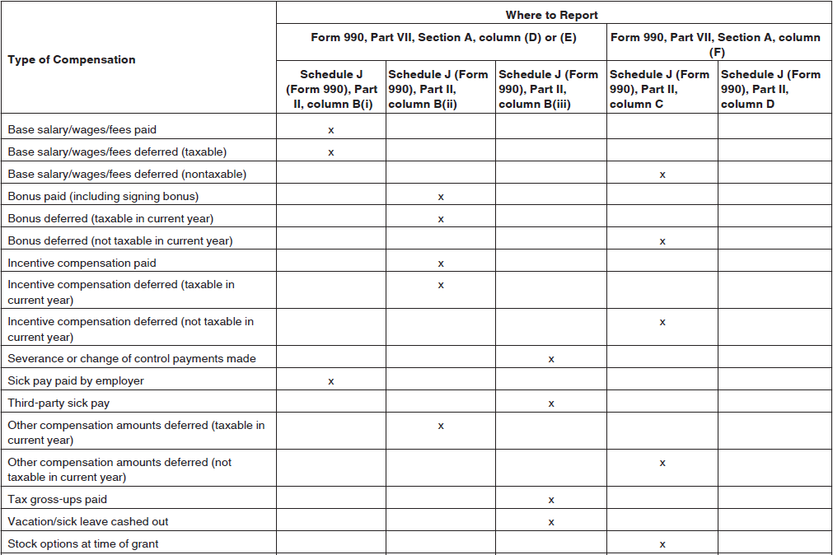
Form 990 compensation table

Slide 40
Detailed compensation questions – Schedule J

Slide 41
Form 990, Schedule J
Schedule J serves as a supplement to Part VII.
Part I questions generally must be answered taking into consideration all individuals listed in Part VII, Section A.
Part II compensation detail must be completed for:
Former ODTKEs or HCEs reported on Part VII
Persons on Part VII whose sum of reportable compensation and other compensation from organization and related organizations exceeds $150,000
Any person on Part VII who received or accrued compensation from an unrelated organization for services rendered to the filing organization

Slide 42
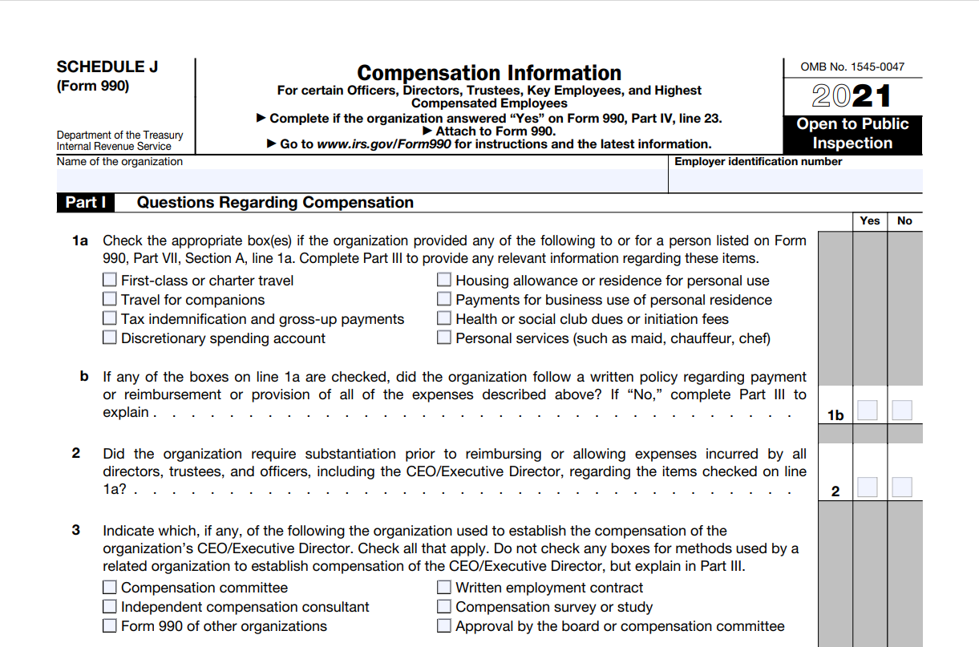
Form 990, Schedule J
Tip
Read each question closely to determine who needs to be considered in the answer.

Slide 43
Form 990, Schedule J: Part I, line 1
“Relevant” information to be disclosed for any checked items:
Type of benefit
Person or category of persons who received the benefit
Whether the benefit was treated as taxable
If the organization followed its written policy, answer “yes” to Schedule J, Part I, line 1b:
If not, explain in Part III who determined the organization would provide the benefit, and explain the decision-making process.

Slide 44
Form 990, Schedule J: Part I, line 2
Line 2 refers only to directors, trustees and officers.
An accountable plan is a reimbursement or other expense allowance arrangement that satisfies the requirements of IRC Section 62(c) by meeting requirements of business connection, substantiation and returning amounts in excess of substantiated expenses.
Organization can answer “yes” if it checked discretionary spending account box on line 1a and required substantiation of expenses under rules for accountable plans for all listed benefits on line 1a other than for discretionary spending accounts.

Slide 45
Form 990, Schedule J: Part I, line 3
Check only the boxes for any items used to establish compensation of the CEO/executive director (top management official):
For example, simply having a current written employment contract for the CEO would not warrant checking that box. Using written employment contracts (say, from former or similar employers) to establish your CEO’s compensation would warrant checking that box.
Explain in Part III if organization relied on a related organization that used one or more methods outlined in line 3 to establish top management official’s compensation.

Slide 46
Form 990, Schedule J: Part I, line 4
List in Part III the names of listed persons paid amounts during year by filing organization or a related organization under any arrangement described in lines 4a (severance), 4b (supplemental nonqualified retirement plan) or 4c (equity-based compensation), and report amounts paid during the year to each.
For 4b and 4c, also describe in Part III terms and conditions of arrangement in which one or more listed persons participated during year, regardless of whether any payments to listed person were made during year.

Slide 47
Form 990, Schedule J: Part I, line 5
“Yes” if organization paid or accrued, with respect to a listed person, any compensation contingent upon and determined in whole or in part by:
Revenues (gross or net) of one or more activities of organization or a related organization
or
Revenues (gross or net) of organization or a related organization as a whole
Net revenues means gross revenues less certain expenses but does not mean net income or net earnings.
Describe such arrangements in Part III.

Slide 48
Form 990, Schedule J: Part I, line 6
“Yes” if the organization paid or accrued with respect to a listed person any compensation contingent upon and determined in whole or in part by:
Net earnings of one or more activities of organization or a related organization
or
Net earnings of organization or a related organization as a whole
Describe such arrangements in Part III.

Slide 49
Form 990, Schedule J: Part I, line 7
Answer “yes” if organization provided nonfixed payments not described on lines 5 and 6 for a listed person.
Describe such arrangements in Part III.
Fixed payment is an amount of cash or other property specified in contract, or determined by a fixed formula specified in contract, which is to be paid or transferred in exchange for the provision of specified services or property.
A fixed formula can incorporate an amount that depends upon future specified events or contingencies, provided that no person exercises discretion when calculating amount of a payment or deciding whether to make a payment, such as a bonus.
Amounts paid or accrued to any listed person that are not fixed amounts as defined above are nonfixed payments:
For example, amount paid to a person under a reimbursement arrangement where discretion is exercised by any person as to the amount of expenses incurred or reimbursed is a nonfixed payment.

Slide 50
Form 990, Schedule J: Part I, lines 8 and 9
Line 8 — Initial contract: binding written contract between organization and person who was not a disqualified person (within meaning of Section 4958(f)(1)) with respect to organization immediately prior to entering contract.
Line 9 — Answer “yes” if payments described in line 8 were made under initial contract reviewed and approved by organization following rebuttable presumption procedure.
Rebuttable presumption of reasonableness includes:
Review and approval by independent persons
Comparability data
Contemporaneous substantiation of the deliberation and decision

Slide 51
Polling question 6
Q
Which of the following statements is true?
A
If the exempt organization is required to complete a Schedule J, then Schedule J should include relevant information for all individuals reported in Part VII.
B
The Schedule J questions should be answered only from the perspective of the filing organization.
C
Establishing the rebuttable presumption of reasonableness means that the organization cannot be found to have paid unreasonable compensation.
D
None of the above.

Slide 52
Form 990 compensation reporting to avoid automatic excess benefit transactions

Slide 53
Form 990 compensation reporting to avoid automatic excess benefit transactions
Individuals reported on a 501(c)(3) or 501(c)(4) Form 990 Part VII may include disqualified persons under the Intermediate Sanctions rules in IRC §4958.
A disqualified person is any person who was, at any time during the five-year period ending on the date of the transaction, in a position to exercise substantial influence over the organization’s affairs.

Slide 54
Form 990 compensation reporting to avoid automatic excess benefit transactions
An excess benefit transaction is a transaction in which the organization receives less value than it gives up (i.e., non-FMV transactions and excessive compensation).
Excessive compensation paid to officers, directors or key employees
Payment of personal expenses and benefits
Excess of FMV paid for asset acquisitions
Provision of below-market services, rents, loans, etc.
An automatic excess benefit transaction results if the organization provides an economic benefit to a disqualified person and fails to document it as a payment for services.

Slide 55
Form 990 compensation reporting to avoid automatic excess benefit transactions
Consequences of an automatic excess benefit transaction include:
Self-report the initial excise tax = 25% of excess benefit
Second-tier 200% excise tax imposed if the transaction is not corrected in a timely manner
In willful cases, 10% excise tax (capped at $20,000 per transaction) imposed on any organization manager who knowingly approves the transaction
“Organization manager” is defined as an officer, director or trustee of the organization (or any individual with similar powers or responsibilities).

Slide 56
Form 990 compensation reporting to avoid automatic excess benefit transactions
To avoid having an automatic excess benefit transaction, the organization must clearly indicate its intent to provide an economic benefit as compensation for services by providing written substantiation to that effect.
Written substantiation can include any of the following:
Documenting the benefit in a written employment contract executed and approved on or before the date on which the benefit is provided
Documenting the governing body approved the benefit before it was paid
Reporting the benefit as compensation on Form W-2 (for disqualified persons who are employees), Form 1099-NEC (for disqualified persons who are not employees) or the organization’s Form 990
Having the disqualified person report the benefit as income on their income tax return

Slide 57
Form 990 compensation reporting to avoid automatic excess benefit transactions
Form 990 additional disclosures for excess benefit transactions
Part IV, Line 25a
Asks whether the filing organization engaged in an excess benefit transaction with a disqualified person during the year
A “yes” answer requires completion of Schedule L, Part I to report the transaction

Slide 58
Form 990 compensation reporting to avoid automatic excess benefit transactions
Part VI, Line 15
Asks questions to indicate whether the filing organization established the rebuttable presumption regarding the compensation of its CEO, executive director, or top management official and its other officers or key employees
An automatic excess benefit transaction complicates a claim that the rebuttable presumption should be invoked.
Appropriate documentation, one of the three elements needed to claim the presumption, includes records noting:
The terms of the compensation that was approved and the date it was approved
The members of the governing body who were present during the debate on the compensation arrangement that was approved and those who voted on it

Slide 59
Remote worker tax and other considerations

Slide 60
Remote worker tax policy considerations
What levels of approval are necessary for authorizing an employee to work remotely or hybrid?
How often will you review/audit the work location of remote workers?
1
2
Will certain states be excluded from remote-work arrangements based on cost and complexity ranking?
7
How will you confirm the physical work location of remote workers?
Remote worker policy considerations
3
What information resources are available to confirm tax compliance in new work jurisdictions?
6
4
What benefits and resources will be available to remote workers, and what is the tax treatment in his or her jurisdiction?
5
Who will be responsible for business registrations in the new work jurisdictions?

Slide 61
Why does the remote worker’s physical location matter?
If an employee works from home on more than an occasional basis, the physical location of the remote work is generally treated just as any place of business of the employer. This has significant implications for employers if the requirements of the remote worker’s state/locality are ignored.
State/local wage and employment law
Remote worker physical location
State/local payroll taxes and business taxes
State income/withholding
Local tax/withholding
Local occupational license fees
New-hire reporting
State unemployment insurance
Disability insurance
Paid family and medical leave insurance
Other state/local payroll tax
State tax exemption
State exempt organization filing requirements
Sales and use tax
Minimum wage
Frequency of pay
Overtime pay
Timing for final wages
Payment of accrued vacation
Requirement for unpaid leave
Limitations on deductions from pay
Direct deposit/pay cards
Employee notices/posters
Workers’ compensation
Other employment law
Workplace health and safety law
Risks
Backpay awards, settlements and legal fees
Tax penalty and interest
Loss of employee morale
Loss of business reputation

Slide 62
Full-time remote worker
Home office
Employer office
1
Work from home 100%
2
This is the work state
Convenience of employer rule?
Income tax withholding
★
Unemployment
insurance
❖
Yes
No
Wage hour and employment law
Income tax withholding
%
★
Income tax applies in the resident state on all wages regardless of where earned.
❖
Unemployment insurance applies in only one state where the employee works most of the time.
%
Nonresident income tax applies only to the portion of wages earned in the state; however, if the convenience of the employer rule applies, all wages paid to the employee from the state of the employee’s home office are subject to nonresident income tax.
⬥
Nonresident income tax applies only to the portion of wages earned in the state.

Slide 63
Polling question 7
Q
Which type of remote worker scenario appears to be the future of your organization?
A
Fully remote worker collaborating virtually.
B
Hybrid worker who works from their home office in another jurisdiction and also works in the employer office several days per month.
C
Commuting worker who has lengthened their commute time to their primary work location office by living in another jurisdiction. They may occasionally work from home.
D
Nearly everyone worked from home for awhile, and now they’re increasingly in the office, but we’re not tracking where they’re working any given day.

Slide 64
Does a remote worker create nexus for purposes beyond payroll taxes?
If an employer has one or more remote workers within a state, the employer may have an obligation to withhold income and other applicable taxes from an employee’s wages, but other business taxes may also apply. Business tax requirements that may apply at the state level include:
State tax exemptions
Sales and use tax
Unemployment tax requirements (even nonprofits will need to register)
Local jurisdictions may also have filing requirements and taxes such as license fees, head count tax, etc.

Slide 65
Options to consider for managing remote worker payroll and compliance
Remote workers employed by org; payroll completed by internal HR/payroll resources:
Pros: no changes from employee’s perspective
Cons: additional resources required to manage multistate payroll and HR/employer requirements
Remote workers employed by a single member LLC:
Pros: isolates the remote worker risk; employees can participate in org’s 403(b); payroll can be easily outsourced to third-party payroll provider for remote workers
Cons: state LLC fees/taxes; internal HR would need to manage state HR/employer requirements
Utilize professional employer organization to manage payroll, benefits and other HR responsibilities for the remote employees in LLC:
Pros: outsource some regulatory and compliance risk
Cons: burden to implement, cost and employee confusion regarding co-employment
Utilize employer of record that serves as the employer for tax purposes while the employee performs work at the institute:
Pros: eliminates regulatory and compliance risk
Cons: different employer with different benefits, policies, etc.; complex to set up and costly

Slide 66
Thank you for joining us today!

Slide 67
EY | Building a better working world
EY exists to build a better working world, helping create long-term value for clients, people and society and build trust in the capital markets.
Enabled by data and technology, diverse EY teams in over 150 countries provide trust through assurance and help clients grow, transform and operate.
Working across assurance, consulting, law, strategy, tax and transactions, EY teams ask better questions to find new answers for the complex issues facing our world today.
EY refers to the global organization, and may refer to one or more, of the member firms of Ernst & Young Global Limited, each of which is a separate legal entity. Ernst & Young Global Limited, a UK company limited by guarantee, does not provide services to clients. Information about how EY collects and uses personal data and a description of the rights individuals have under data protection legislation are available via ey.com/privacy. EY member firms do not practice law where prohibited by local laws. For more information about our organization, please visit ey.com.
Ernst & Young LLP is a client-serving member firm of Ernst & Young Global Limited operating in the US.
© 2023 Ernst & Young LLP. All Rights Reserved.
US SCORE no. 19523-231US 2304-4218826 ED None
This material has been prepared for general informational purposes only and is not intended to be relied upon as accounting, tax, legal or other professional advice. Please refer to your advisors for specific advice.
ey.com

